Slide 1
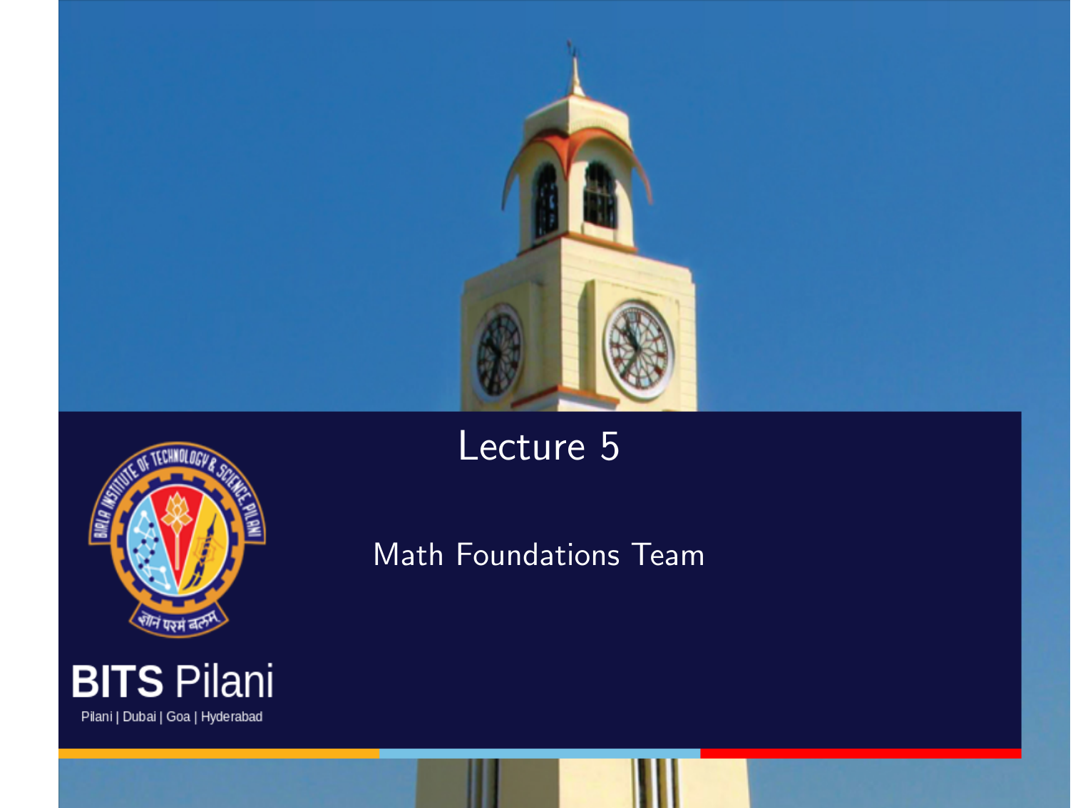

Slide 2
Topics to be covered
In the last lecture we studied eigen values and eigen vectors.
In this lecture we will study three decompositions of Matrices:
1. Cholesky Decomposition
2. Eigen Value Decomposition
3. Singular value Decomposition

Slide 3
Cholesky Decomposition
This decomposition is similar to the square-root operation that gives us a decomposition f the number into identical components, e.g.,16=4*4.
The Cholesky decomposition provides a square-root equivalent operation on symmetric, positive definite matrices that is useful in practice.

Slide 4
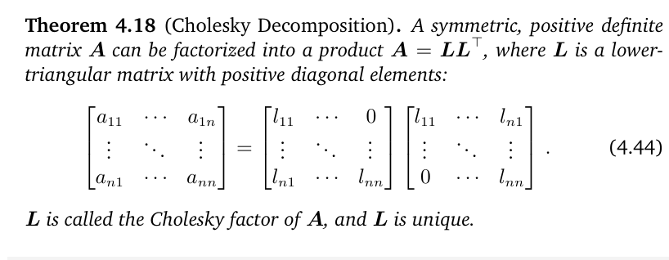
Cholesky Decomposition

Slide 5
Cholesky Decomposition (Example)
Find the Cholesky decomposition of the matrix A = $\left[\begin{matrix}2 & 3 \\ 3 & 5\end{matrix}\right].$
Clearly A is symmetric.
Let $x=\left[\begin{matrix}a \\ b\end{matrix}\right]$ any element in R².
Then $[a, b](\left[\begin{matrix}2 & 3 \\ 3 & 5\end{matrix}\right]$ $\left[\begin{matrix}a \\ b\end{matrix}\right])= \left[a, b\right]\left[\begin{matrix}2a+3b \\ 3a+5b\end{matrix}\right]$
$=2a^{2}+6ab+5b^{2}$
$= {(a+2b)}^{2}+{(a+b)}^{2}$ > 0 if $\left[\begin{matrix}a \\ b\end{matrix}\right]≠\left[\begin{matrix}0 \\ 0\end{matrix}\right]$
Therefore A is positive definite,

Slide 6
Example (Ctd)
Let A = $\left[\begin{matrix}2 & 3 \\ 3 & 5\end{matrix}\right]=\left[\begin{matrix}l_{11} & 0 \\ l_{21} & l_{22}\end{matrix}\right]\left[\begin{matrix}l_{11} & l_{21} \\ 0 & l_{22}\end{matrix}\right]$
${l_{11}}^{2}=2$hence $l_{11}=\sqrt{2}$
$l_{11}l_{21}=3$hence $l_{21}=\frac{3}{\sqrt{2}}$
${l_{21}}^{2} {{+ l}_{22}}^{2}=5$ hence $l_{22}=\sqrt{\frac{1}{2}}.$
Therefore A = $\left[\begin{matrix}2 & 3 \\ 3 & 5\end{matrix}\right]=\left[\begin{matrix}\sqrt{2} & 0 \\ \frac{3}{\sqrt{2}} & \sqrt{\frac{1}{2}}\end{matrix}\right]\left[\begin{matrix}\sqrt{2} & \frac{3}{\sqrt{2}} \\ 0 & \sqrt{\frac{1}{2}}\end{matrix}\right]$

Slide 7
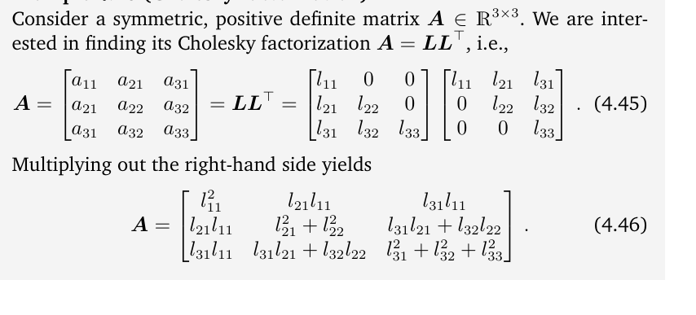
Cholesky Decomposition of 3x3 Matrices

Slide 8
Try this problem:
Find the Cholesky decomposition of the matrix
$A=\left[\begin{matrix}25 & 15 & 5 \\ 15 & 13 & 11 \\ 5 & 11 & 21\end{matrix}\right]$. Ans: $L=\left[\begin{matrix}5 & 0 & 0 \\ 3 & 2 & 0 \\ 1 & 4 & 2\end{matrix}\right]$.

Slide 9
Applications of Cholesky decomposition in ML
In ML the symmetric, positive definite matrices require frequent manipulations. For example the covariance matrix of a multivariate Gaussian variable is symmetric, positive definite. The Cholesky factorization of this covariance matrix allows us to generate samples from a Gaussian distribution.
The Cholesky decomposition also allows us to compute determinants very efficiently. Given the Cholesky decomposition A = LL^{T} , we know that det(A) = det(L)det(L^{T}) = det(L)^{2.} Since L is a triangular matrix, the determinant is simply the product of its diagonal entries. Thus, many numerical software packages use the Cholesky decomposition to make computations more efficient

Slide 10
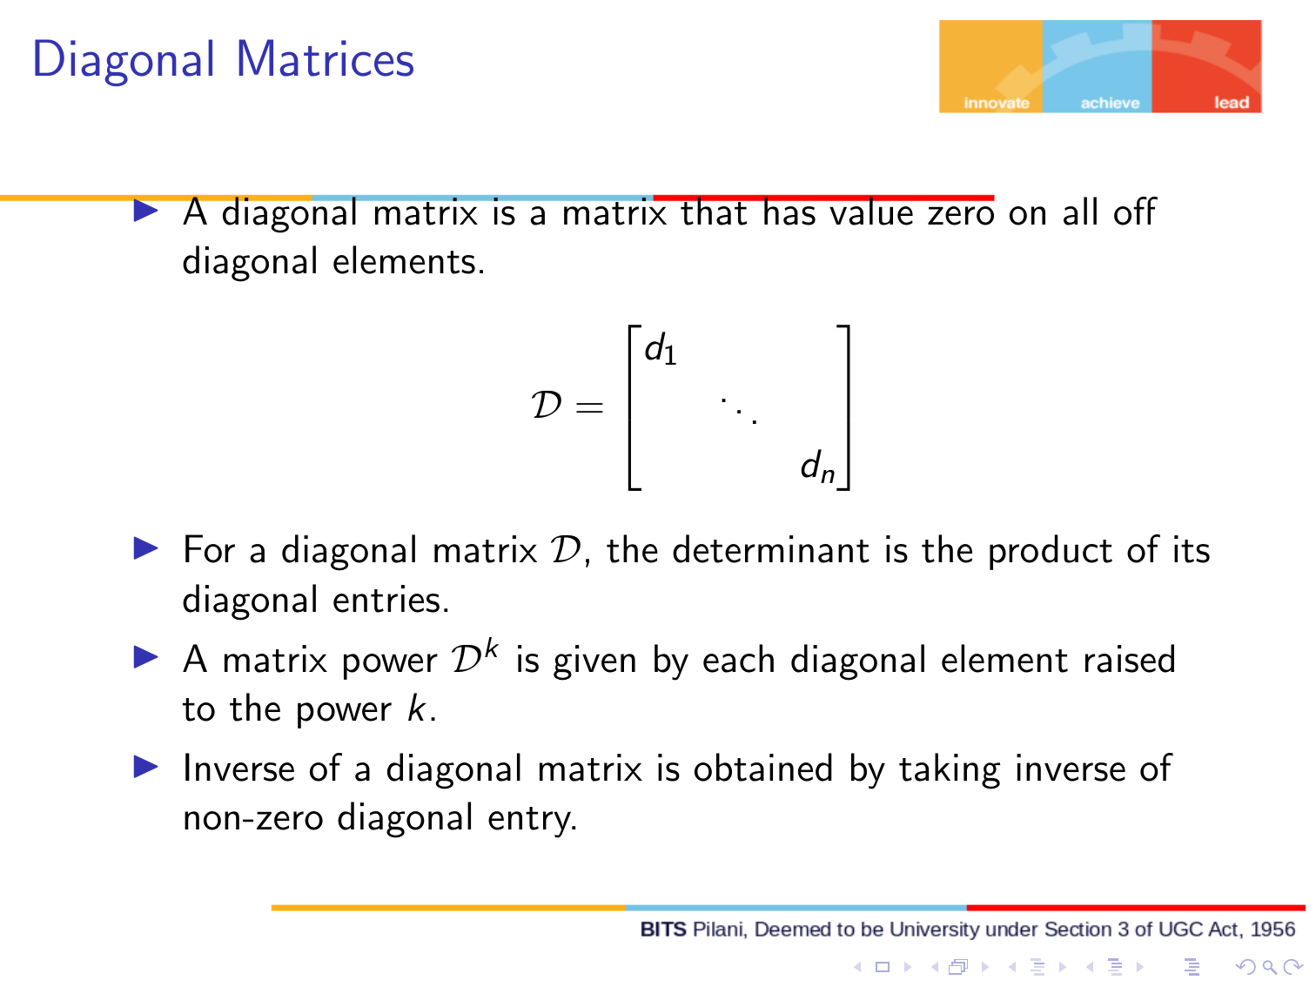

Slide 11
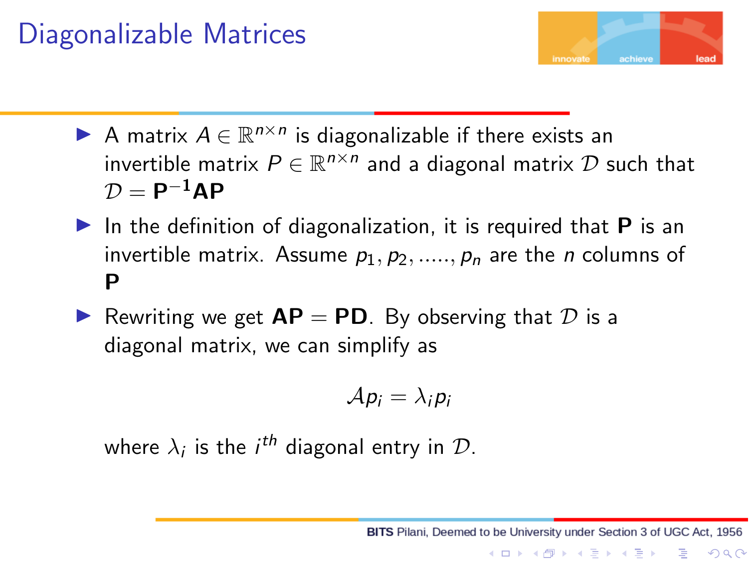

Slide 12
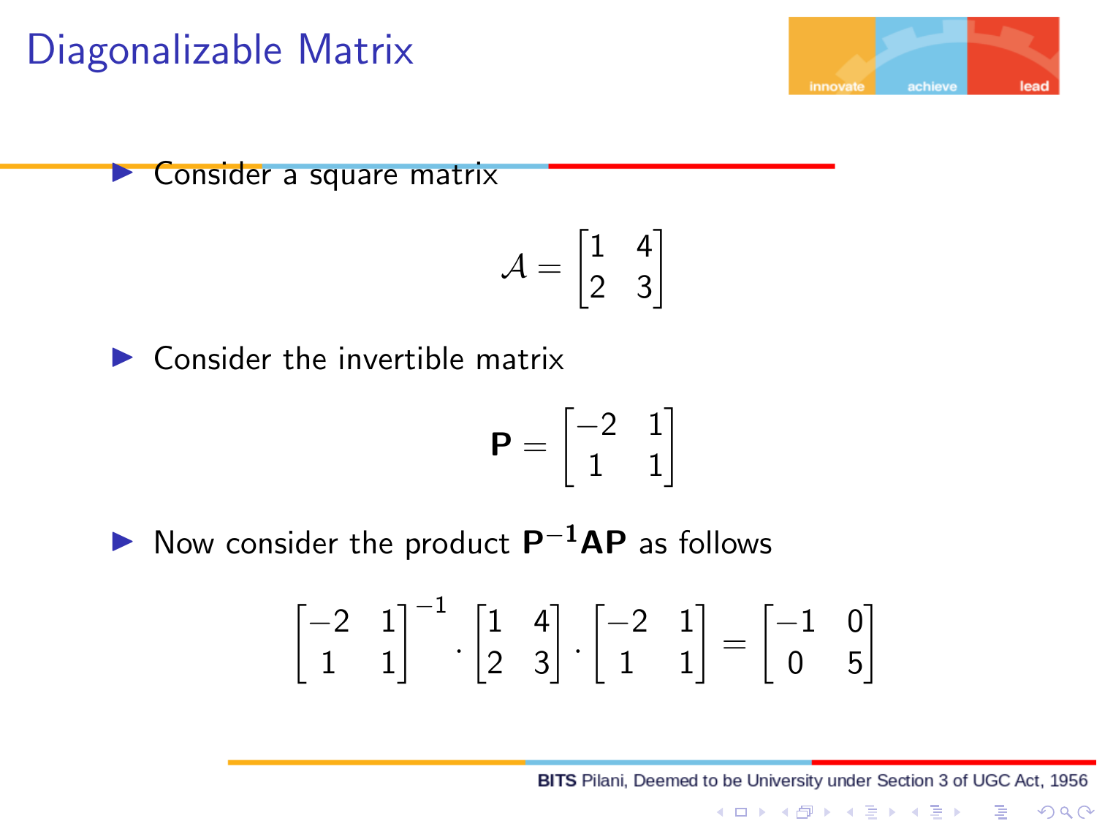

Slide 13
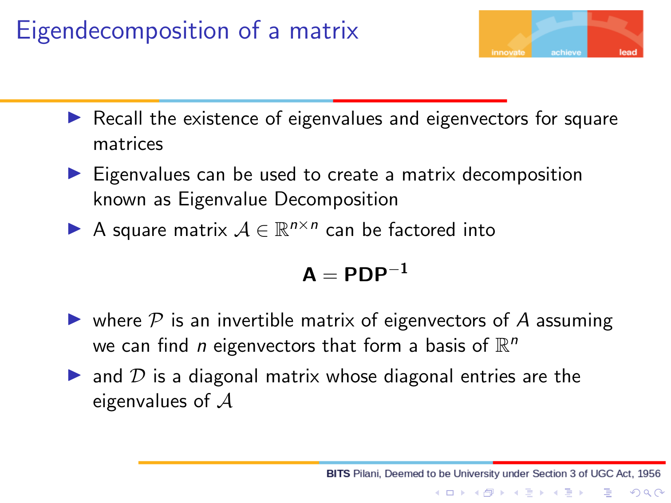

Slide 14
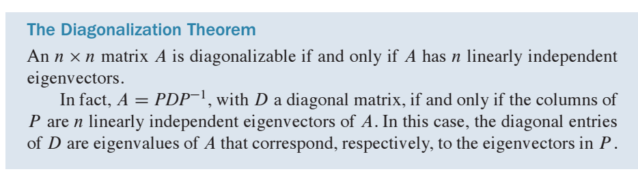
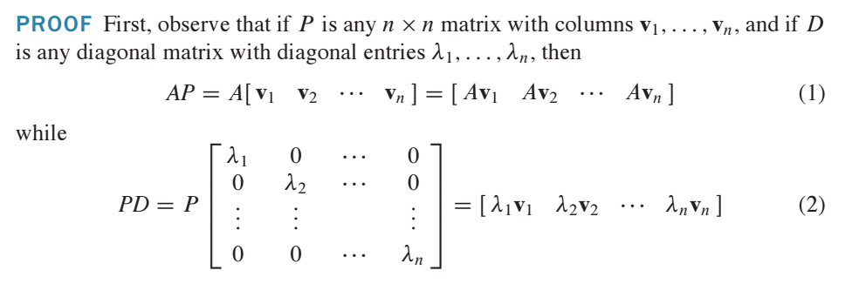
The Diagonalization Theorem
From (1) and (2) we can conclude the theorem.

Slide 15
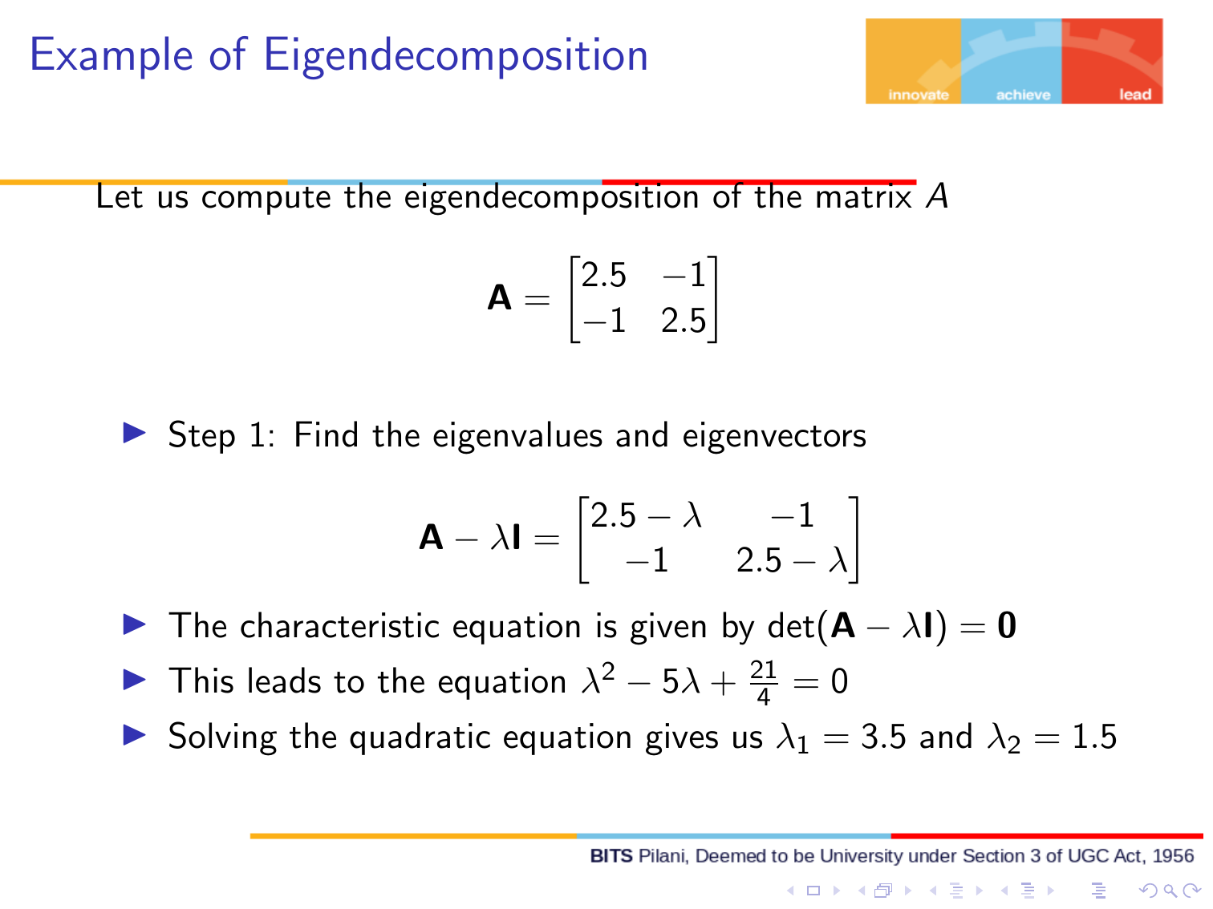

Slide 16
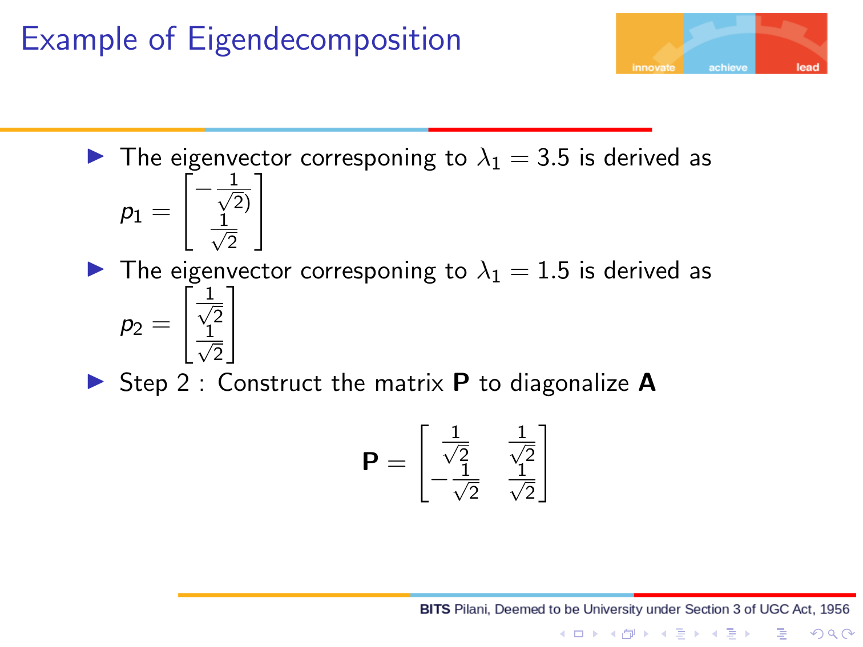

Slide 17
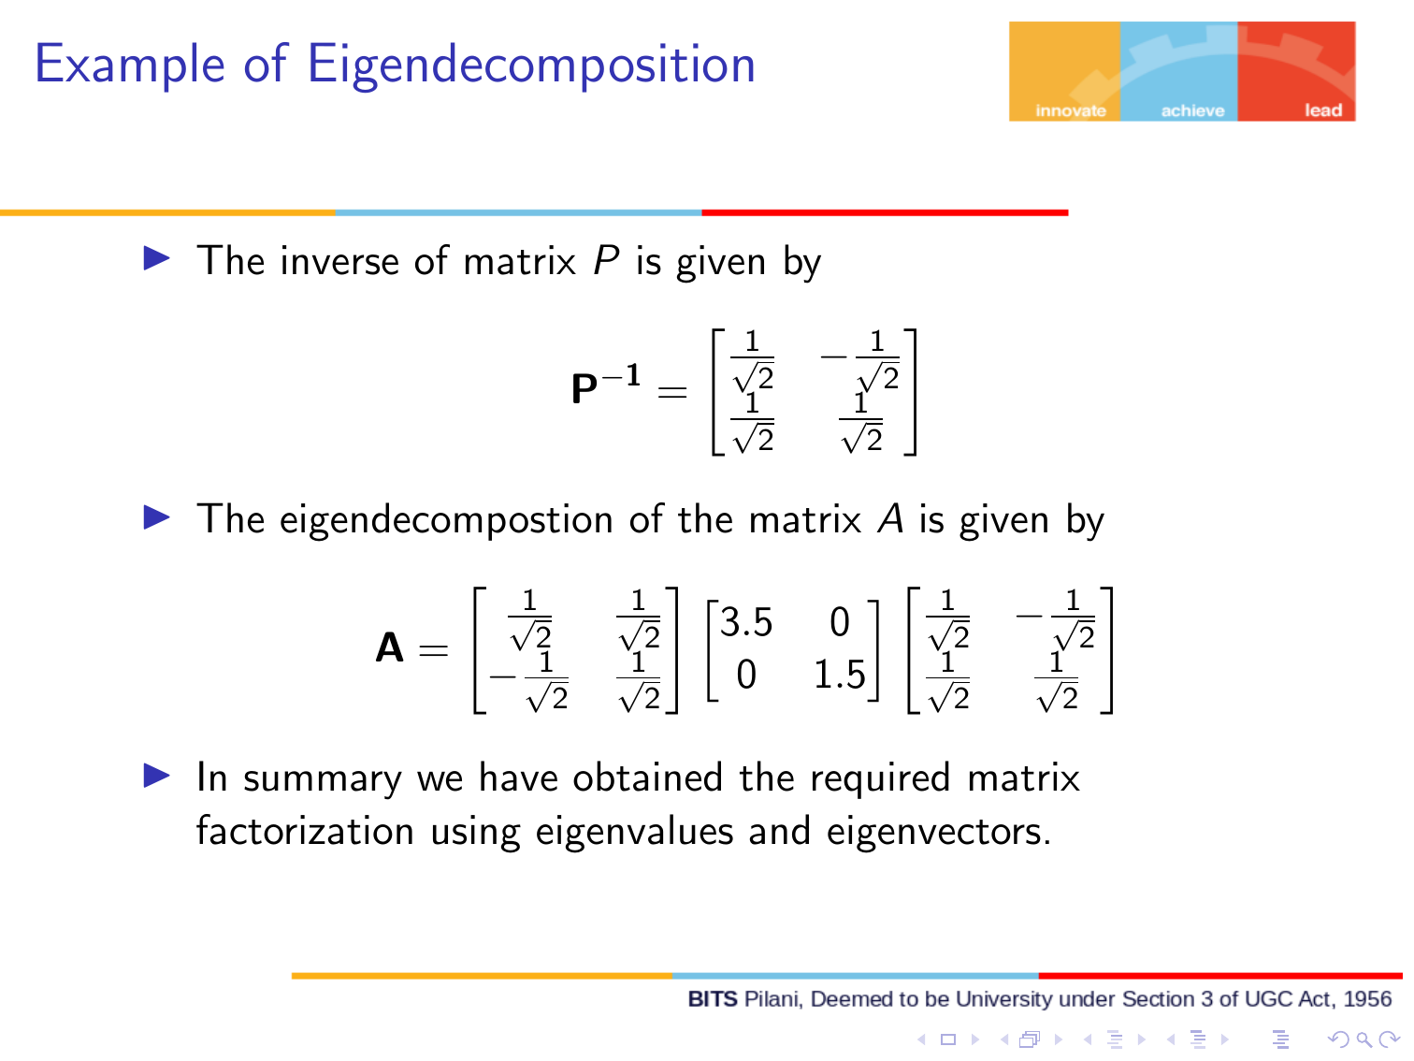

Slide 18
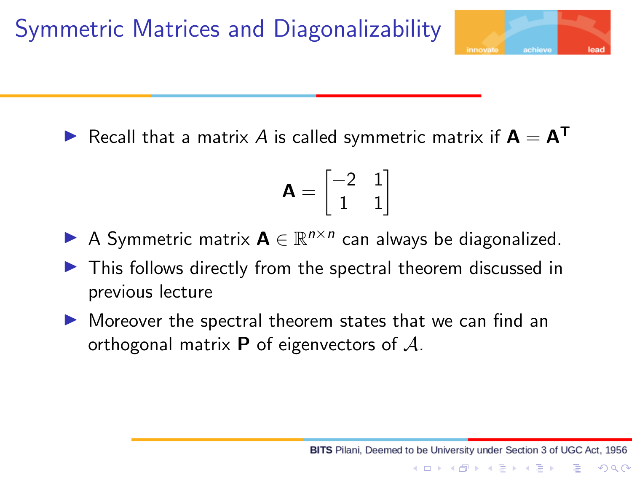

Slide 19
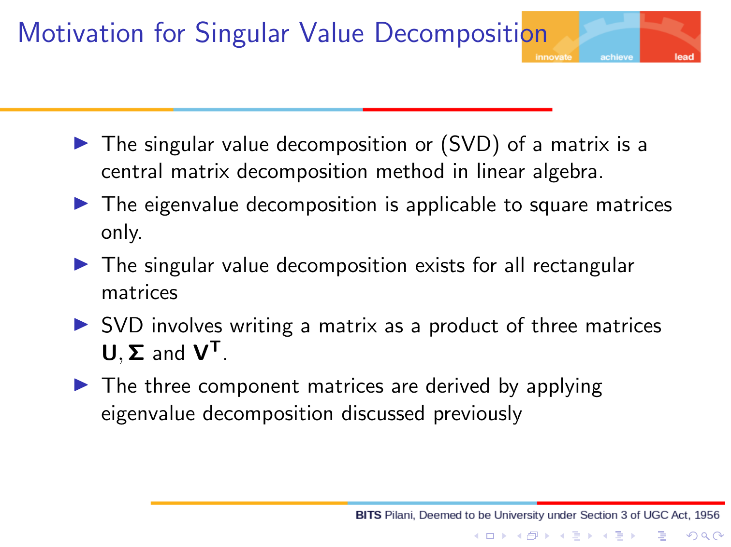

Slide 20
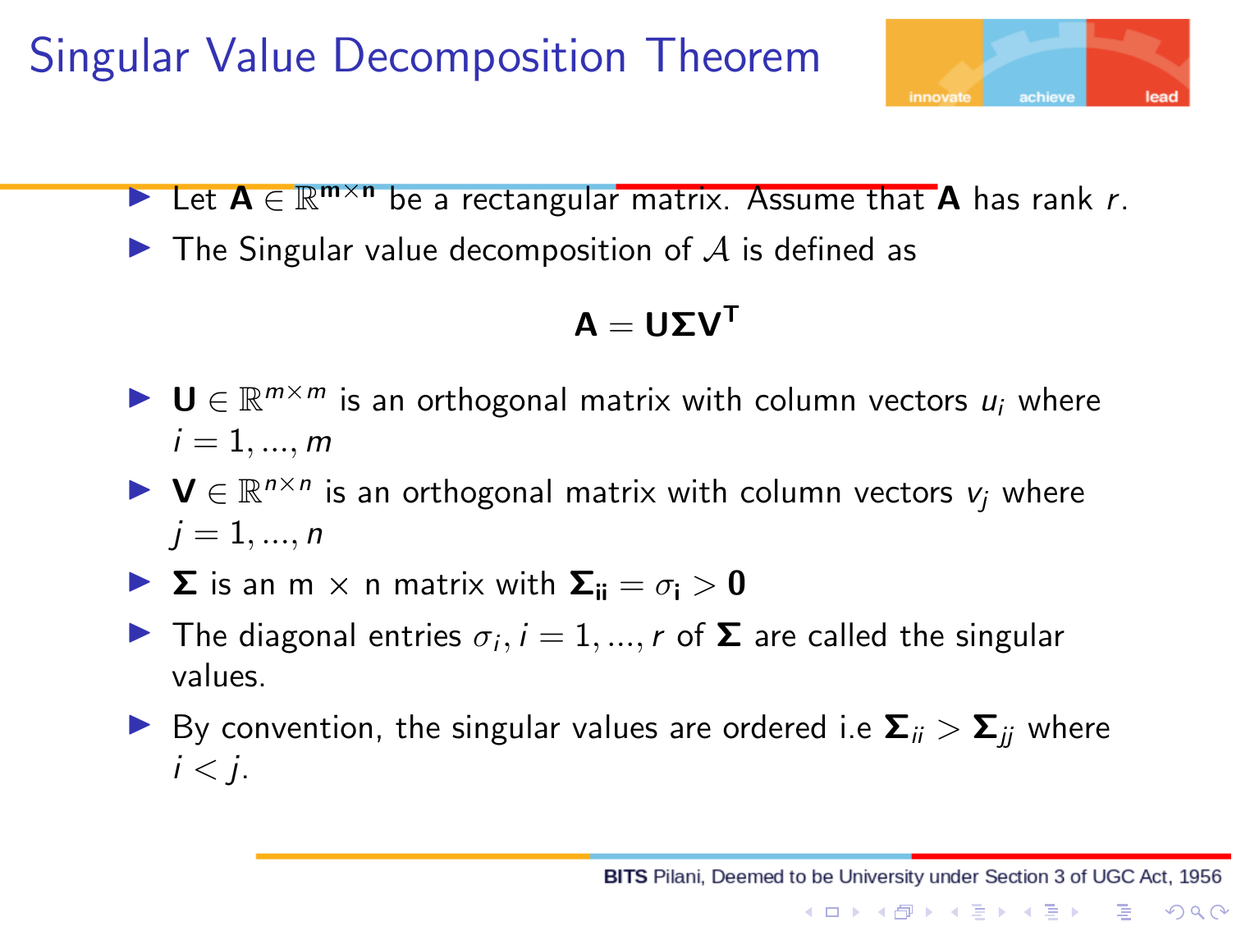

Slide 21
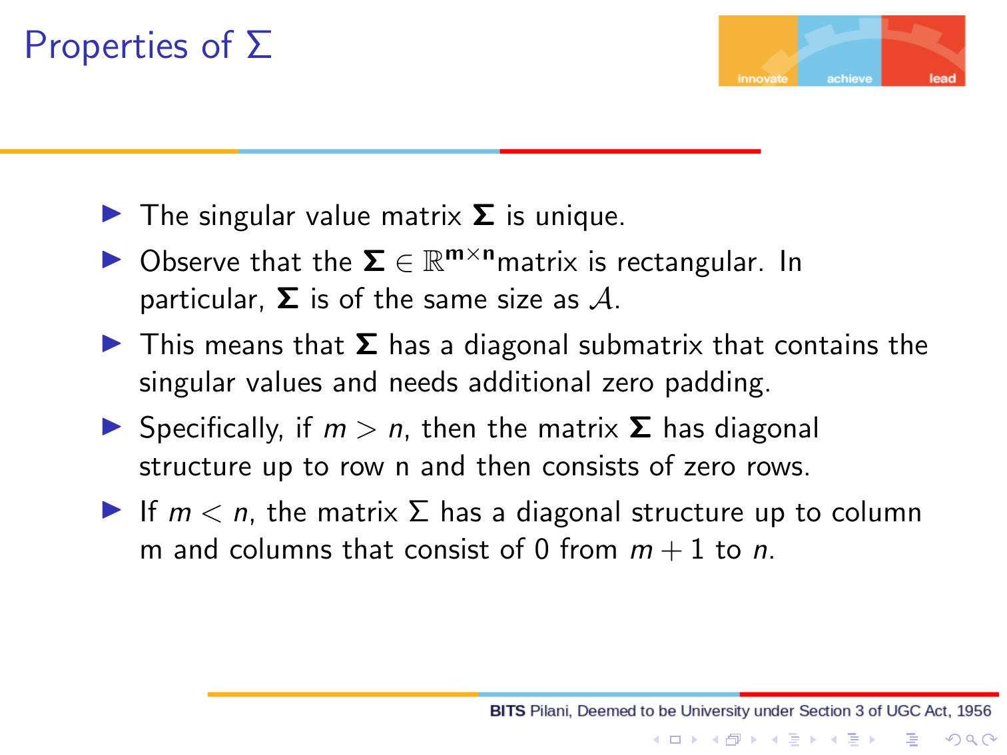

Slide 22
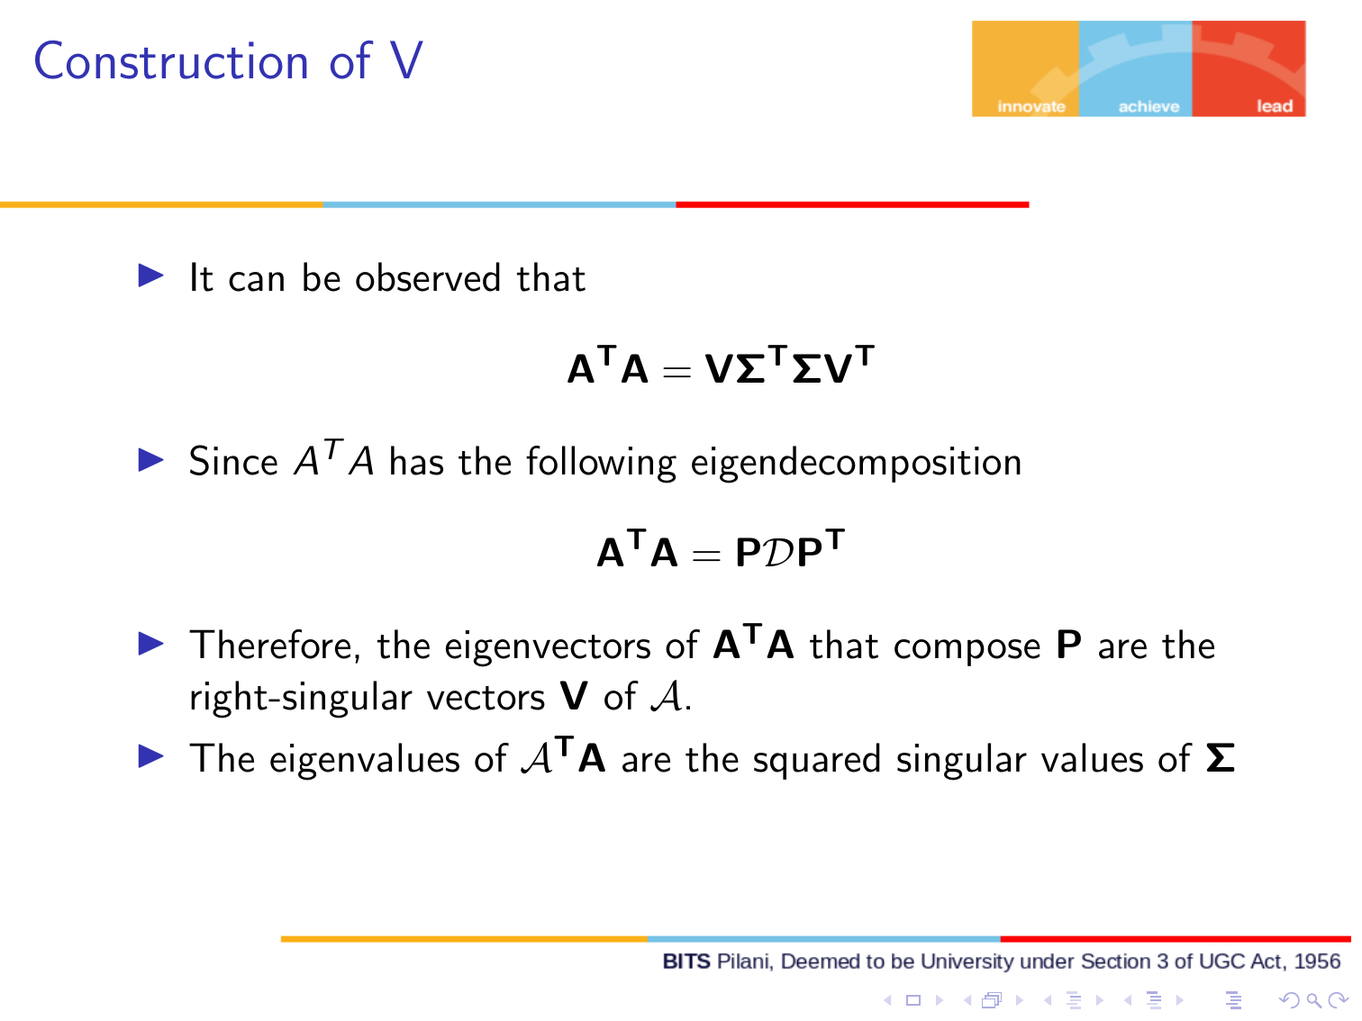

Slide 23
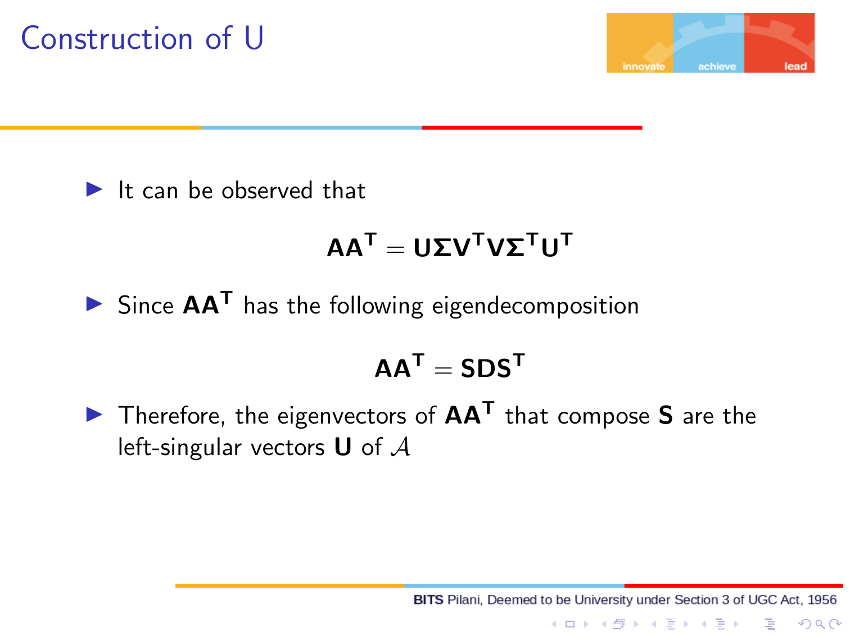

Slide 24
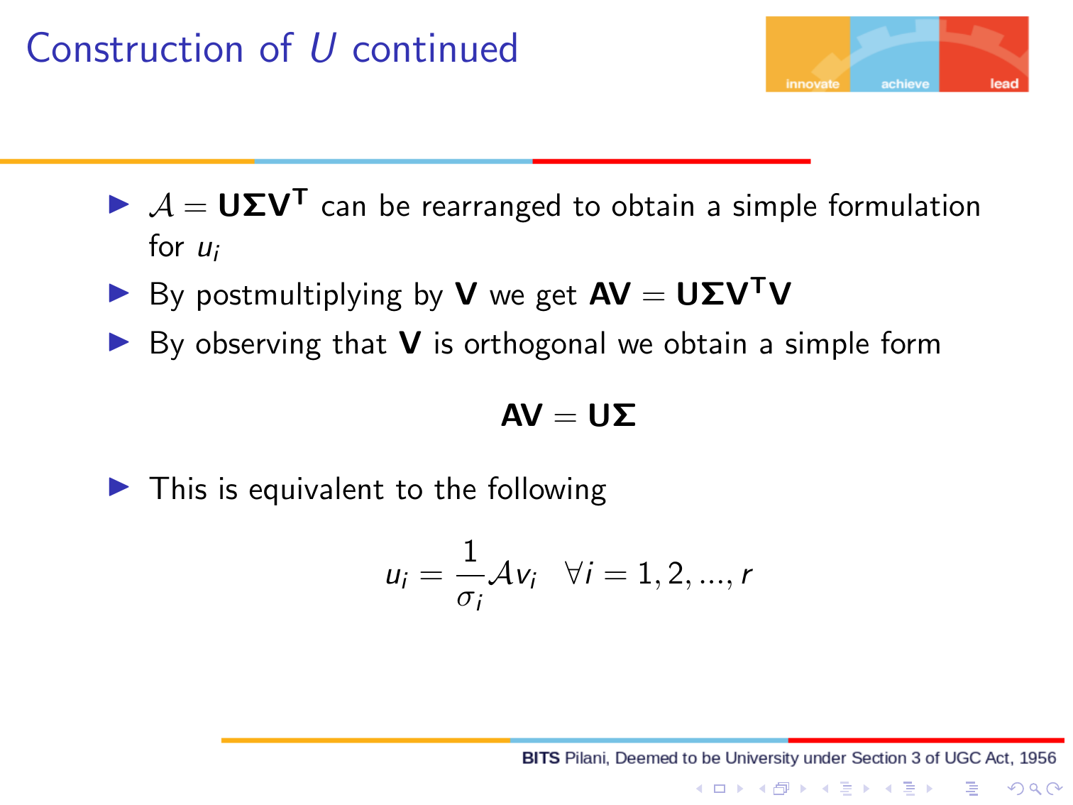

Slide 25
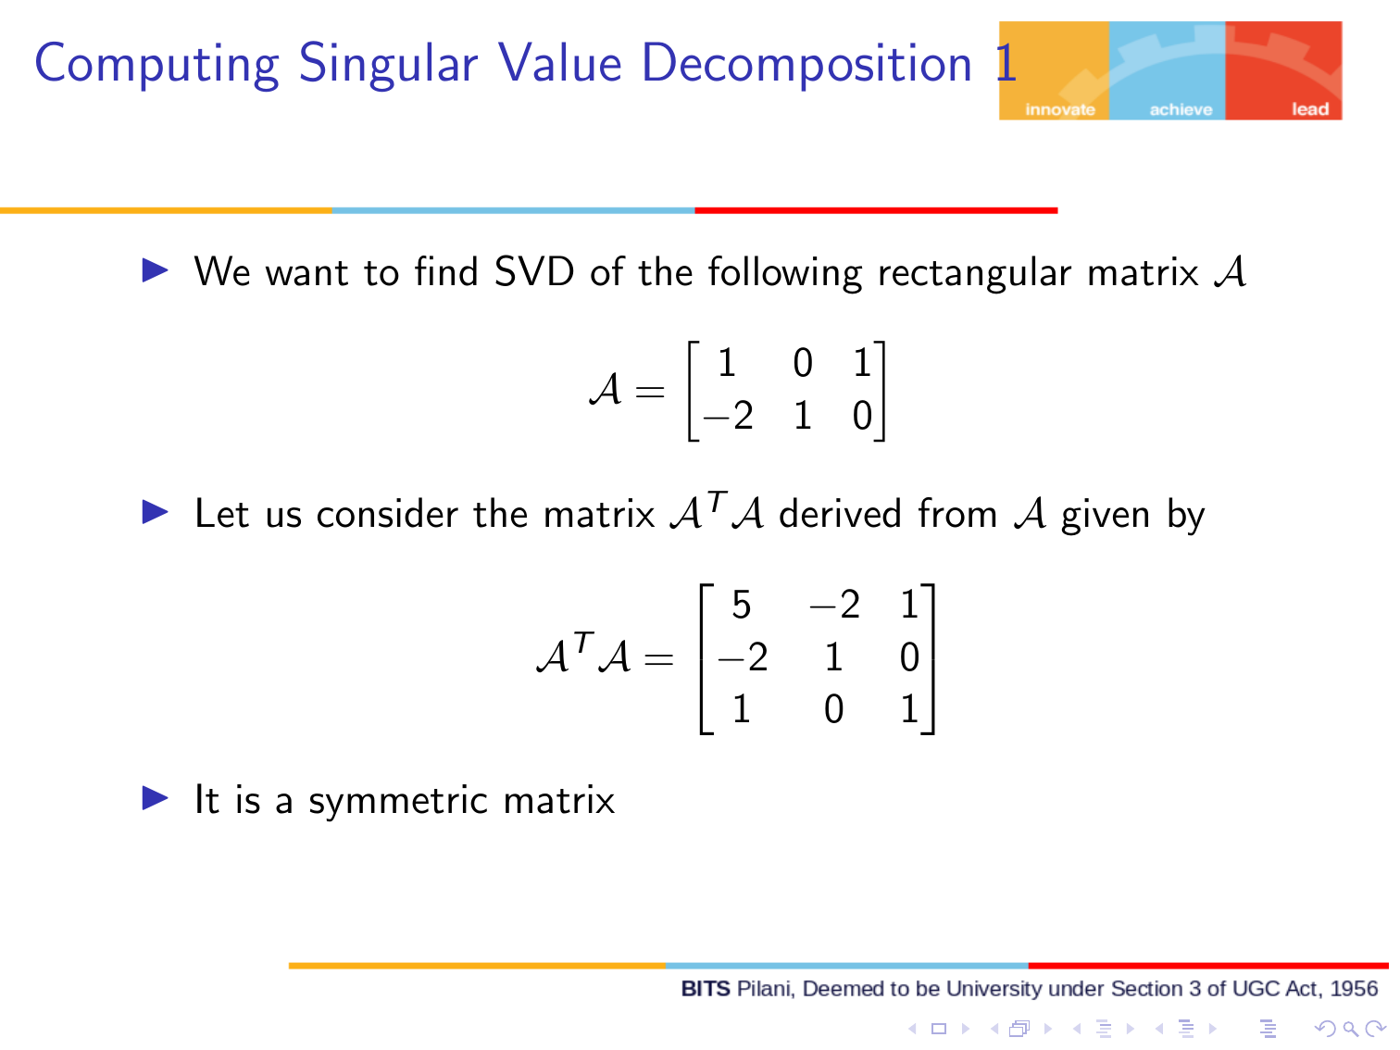

Slide 26
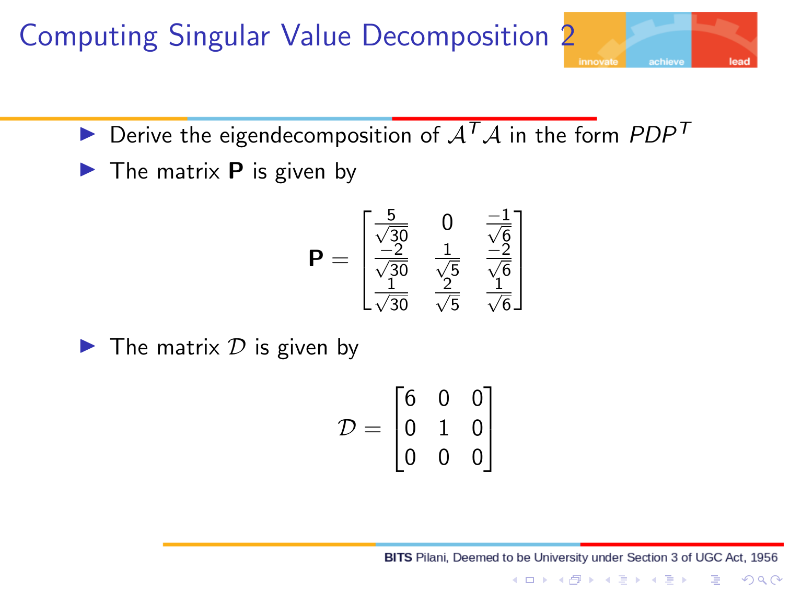

Slide 27
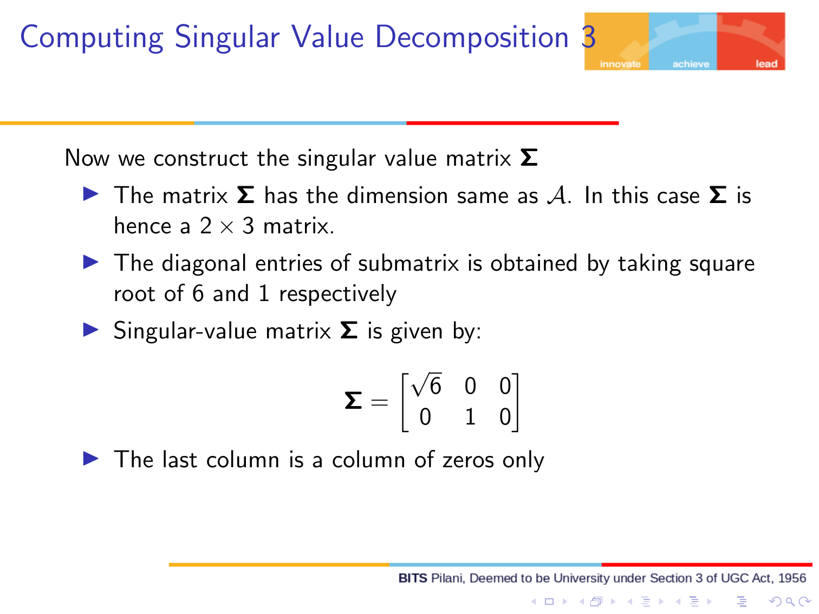

Slide 28
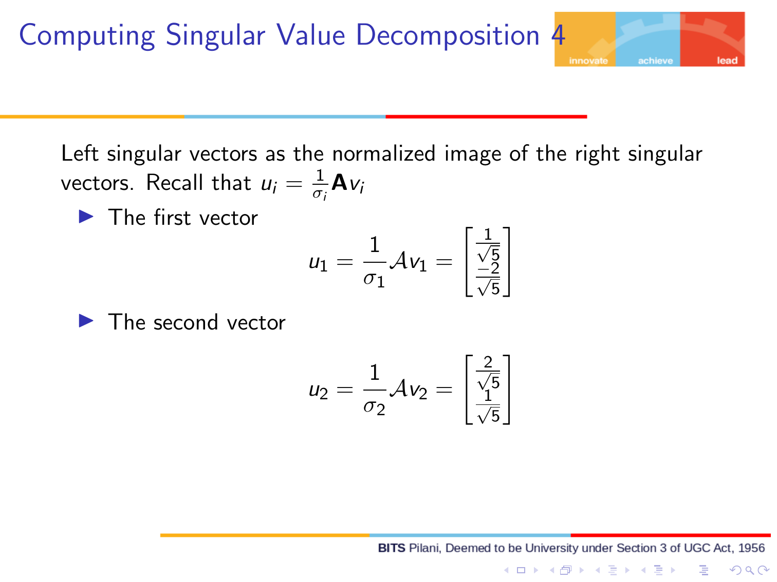

Slide 29
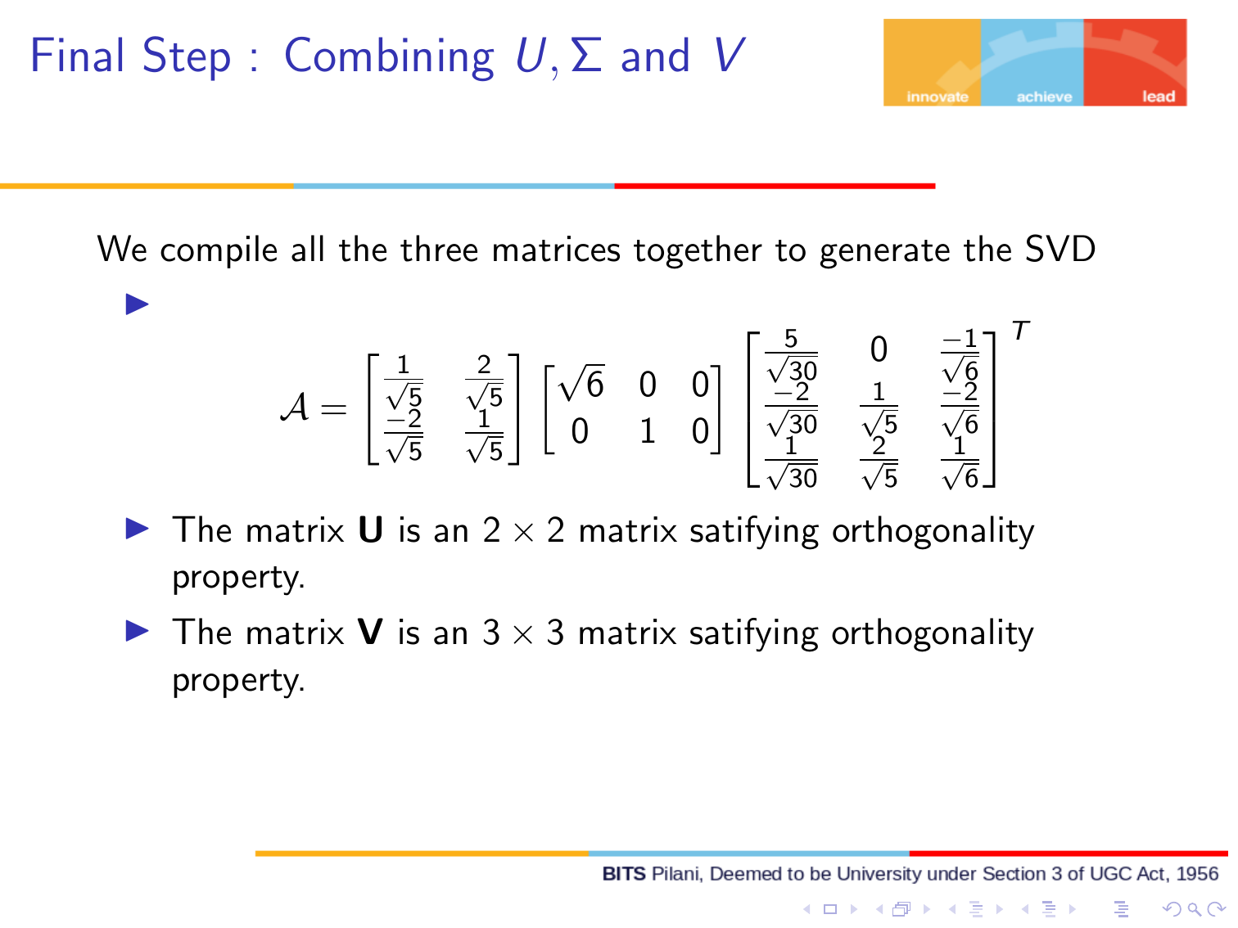

Slide 30
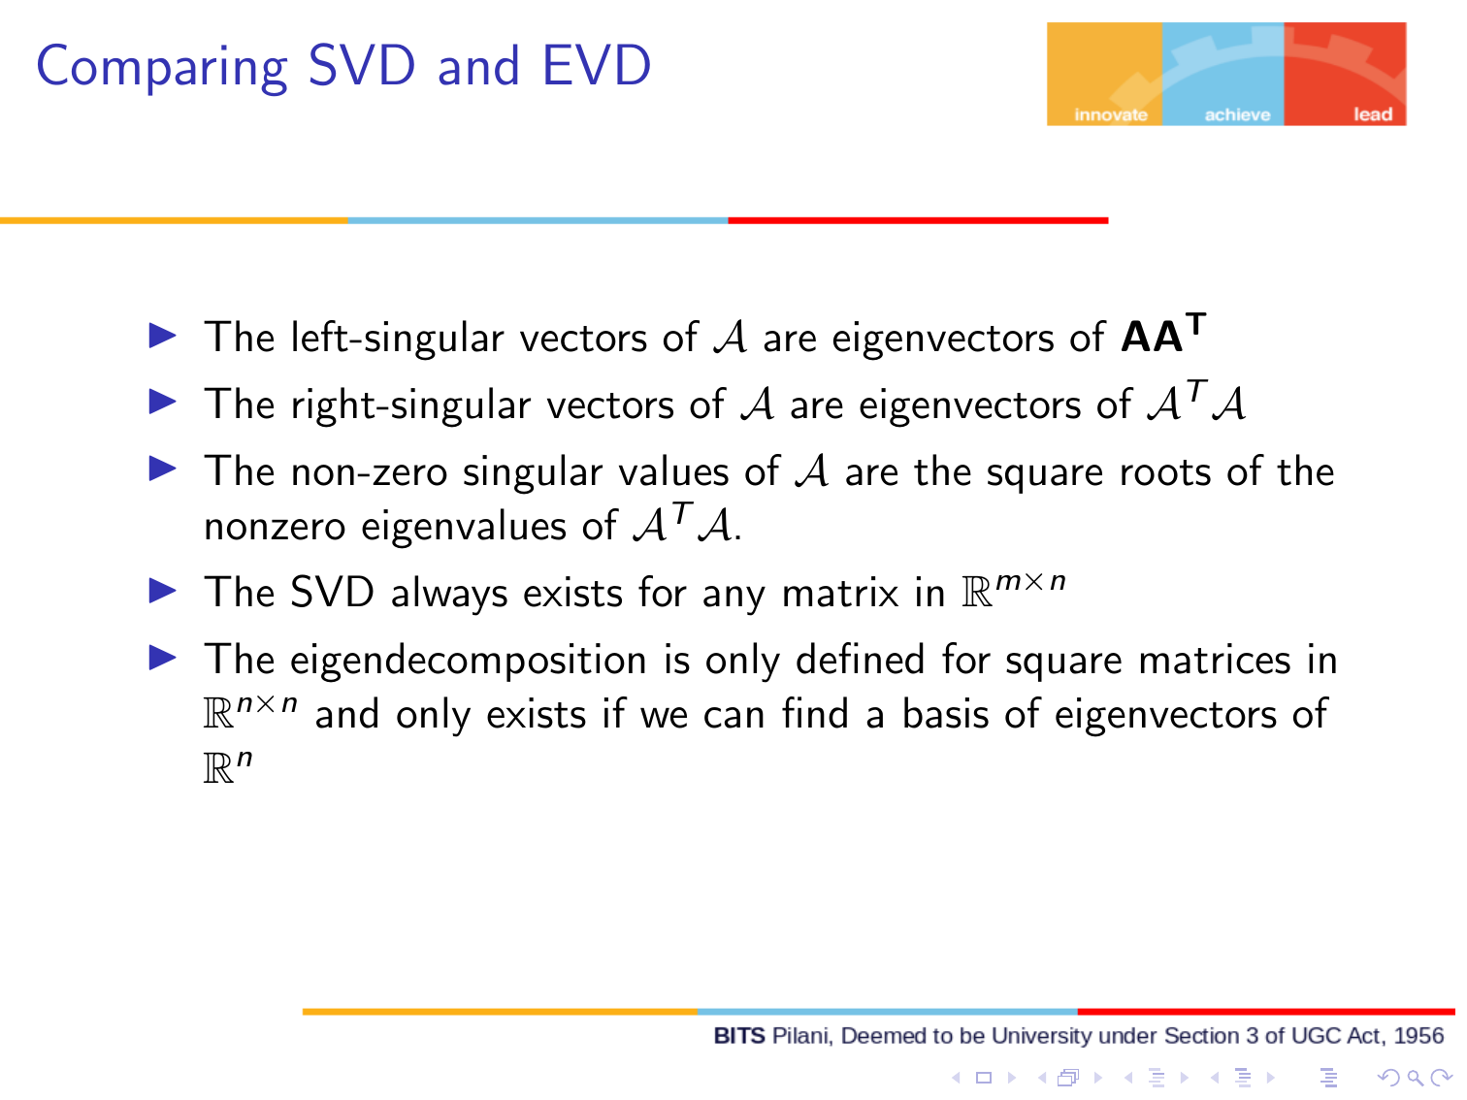

Slide 31
Applications of SVD in ML
Dimensionality Reduction: High dimensional data can be noisy and redundant. We truncate small singular values in ∑ keeping only top k singular values which is known as truncated SVD. As a result we will get reduced feature space while retaining most important information. We will learn this in detail when we study Principal Component Analysis.
Matrix Completion in collaborative filtering: We use SVD to approximate missing entries by reconstruction of the matrix from low rank approximation.
Noise reduction and Denoising: Smaller singular values often correspond to noise . Truncating them yield a clear signal.

Slide 32
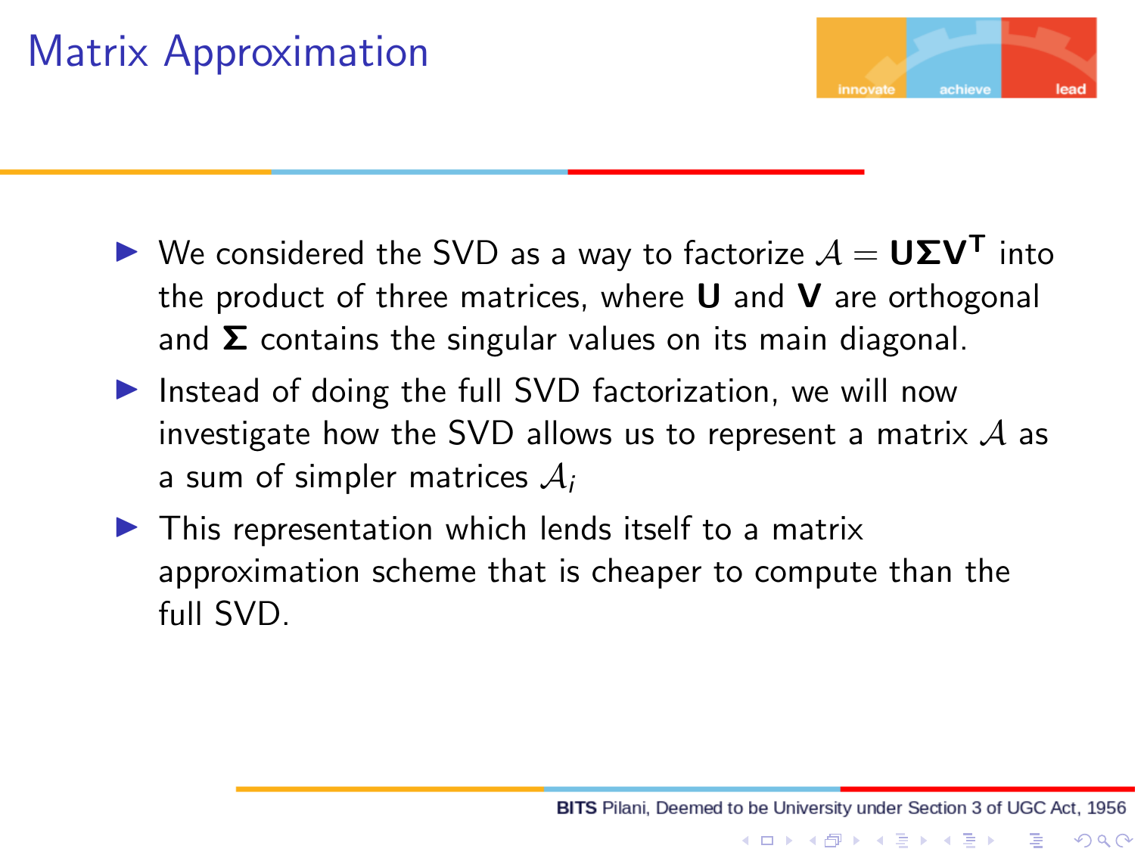

Slide 33
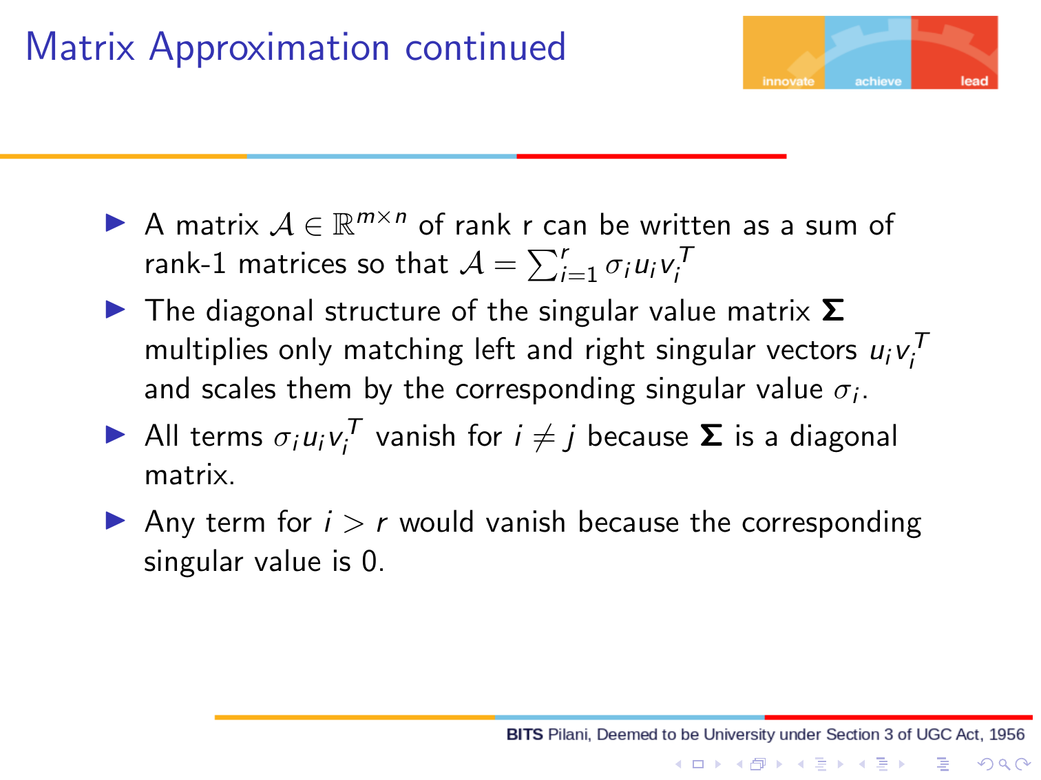

Slide 34
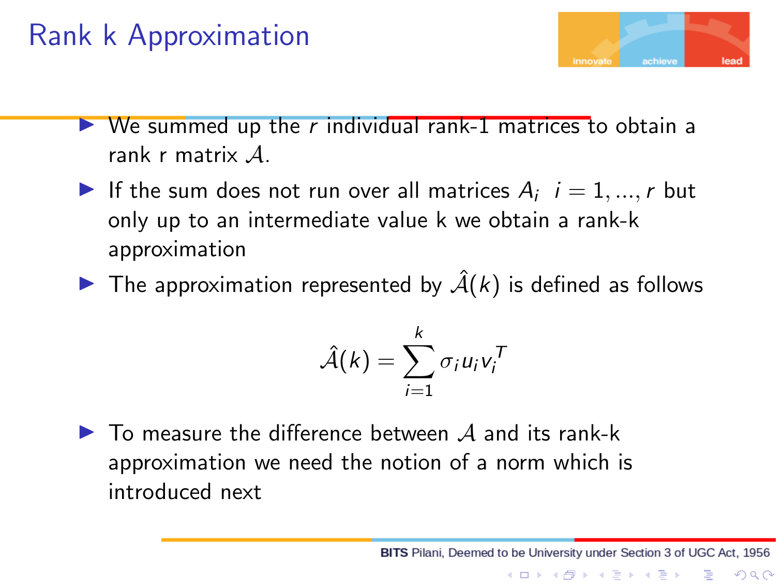

Slide 35
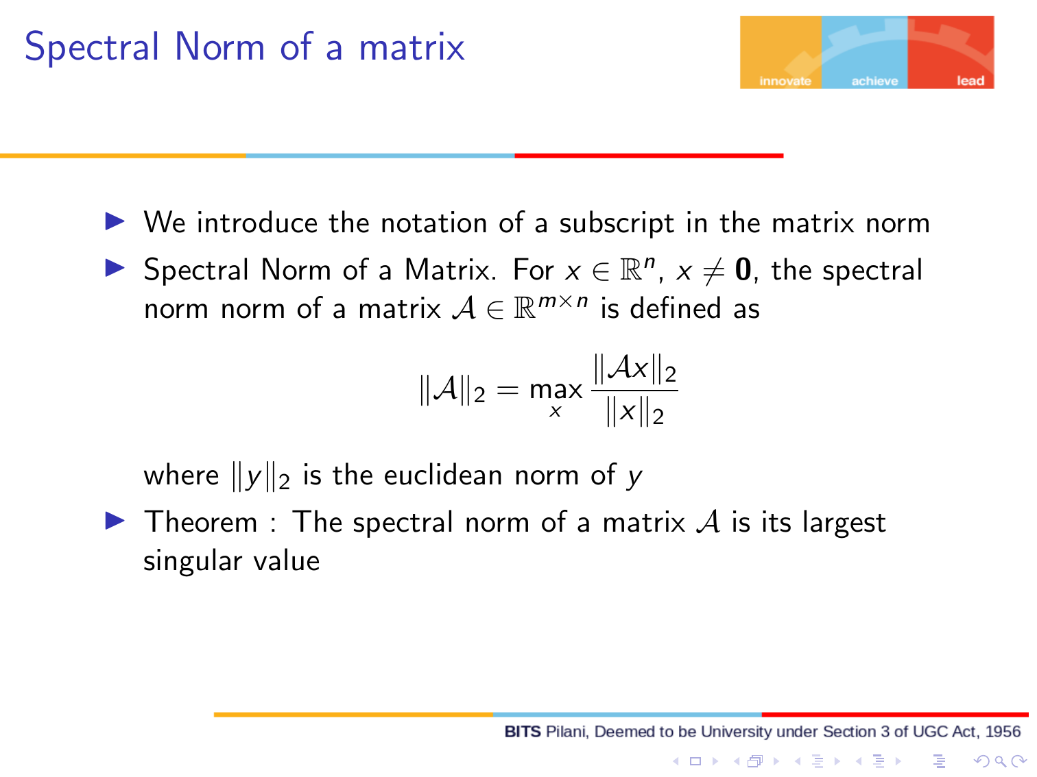

Slide 36
